Slide 1
Simple Linear Regression

Slide 2
Today’s Topics
Review simple linear regression, including
Least squares
Correlation
Prediction
Inference
Hypothesis testing
Connect regression to L₂ loss minimization
Case Studies

Slide 3


Great ShakeOut Earthquake Drill 10/17 @ 10:17

Slide 4
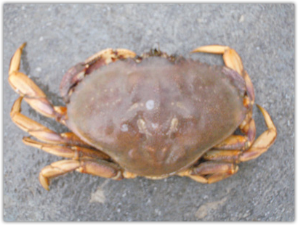
Cancer Magister aka Dungeness Crab
All crab photos courtesy of Oregon Fish and Wildlife

Slide 5

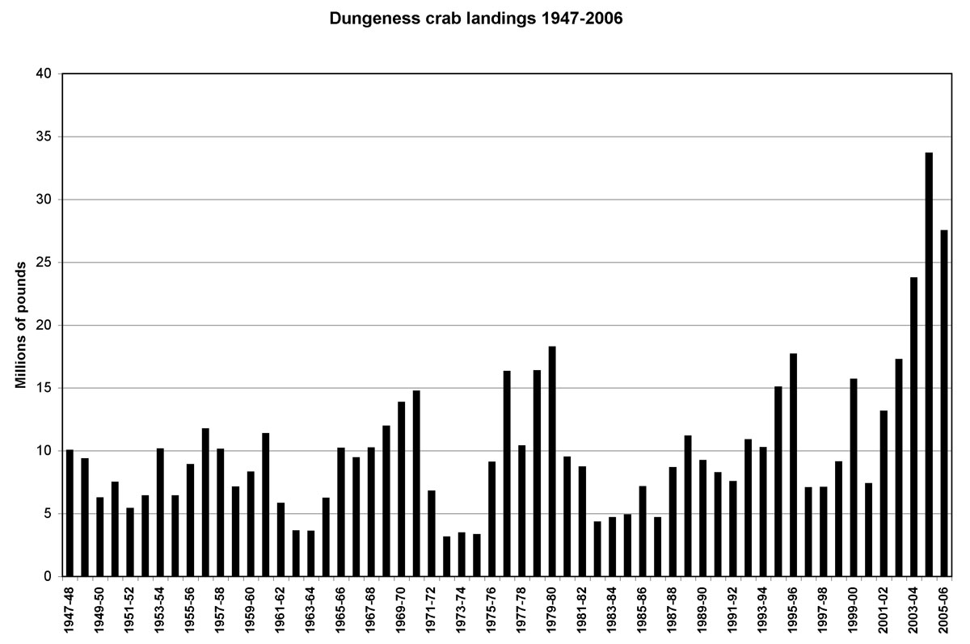
Fishing Regulations
Male crabs only
No fishing in mating season
Limits on the numbers caught
Lift Restrictions on Fishing Female Crabs?

Slide 6
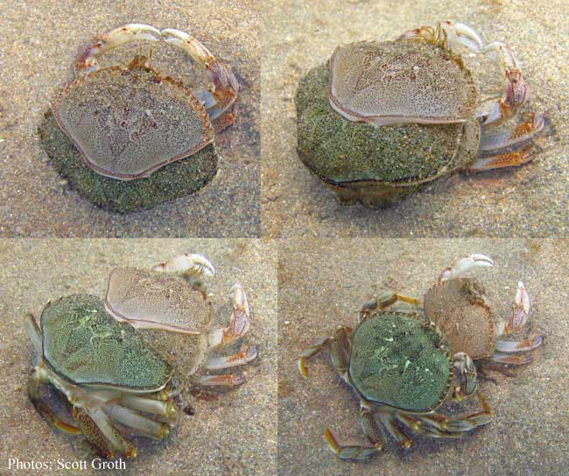
General Problem
Want to be sure that females have an opportunity to produce offspring for a few years before fished
Can we use size to tell how old the crab is?
Crabs has exoskeletons, which they shed every year - This makes it hard to estimate the age of a crab

Slide 7
Answerable Question: Given a crab’s postmolt size, Estimate how much it grew?
With this tool, researchers can estimate the age of a crab.

Slide 8

Data Collection Methods
Crabs were caught in mating embrace,
Females measured before and after molting
452 crabs
Variables
Premolt size (mm)
Postmolt size (mm)
Increment (mm)

Slide 9
Univariate Distributions
But what is their joint relationship?
We see that postmolt size and increment are both unimodal and somewhat skewed. Growth increment is right skewed and postmolt size is left skewed.

Slide 10
Guess what the correlation is like
A
B
C

Slide 11
Relationship: postmolt & increment
Correlation = -0.77
Rough linear association

Slide 12
How can we use postmolt carapace size to predict the growth increment? e.g., what do we predict for growth increment of a crab with 135 mm postmolt carapace?

Slide 13
Crabs with postmolt size 135
(to the nearest 2.5 mm)

Slide 14
Crabs with postmolt size 135
(to the nearest 2.5 mm)
How would we summarize the growth increment for this subgroup?

Slide 15
Increment Distribution for fixed Post size

Slide 16
For each bin of crabs
(postmolt size, growth increment)
For a bin of crabs with same postmolt size, predict increment
We find the constant that minimizes L₂ empirical risk for the growth increment of crabs in a bin

Slide 17
Avg Increment for each postmolt bin

Slide 18
Averages Roughly fall on a line
And, using all of the data gives us a a better fit

Slide 19
Average Empirical Risk
For all of the data together:
Minimize empirical risk for estimating crab increment by a linear function of postmolt size

Slide 20
Derivative with respect to a
Derivative with respect to b
Set to 0 and solve for a and b

Slide 21
Minimization:
Nice interpretation:
Predict growth increment to be
30 mm less 10% of the postmolt size
For a 135 mm postmolt crab, we predict its increment was
30 – 0.1x135 = 16.5 mm
Our binned mean was
15.6 mm
Which is better?
If the relationship is roughly linear, then using all of the data to fit the line gives a better prediction

Slide 22
Fitted parameters:
Regression line:
Rearrange terms:
For an x that is, say 2 standard units above/below average, the regression line estimates y to be 2r standard units above/below average.

Slide 23
Least Squares Regression
Some Important Concepts

Slide 24
Correlation

Slide 25
Correlation measures the strength of linear association between x and y
Correlation is a measure for two quantitative variables
Need to plot the data to check if the relationship is linear
Correlation is unitless

Slide 26
Example Correlations for data with positive linear association (SDs = 1)
0.95
0.75
0.50
0.30
0.10
Should scale the data to have SD 1 before visually assessing the linear association

Slide 27
SAME regression line and correlation
Graphical methods are important for assessing linearity

Slide 28
Correlation does not imply Causation
Since this is not an experiment where we controlled the size of the postmolt size of the crab and observed its growth, we can not make any causal conclusions
With observational studies we can observe and describe relationships.
We can make predictions, but we need to be careful about the interpretation of the models that we build.

Slide 29
Correlation does not imply Causation
Consider other variable(s) that is highly correlated with x.
Correlation is still informative, even if we can’t assign causality.
.

Slide 30
An example of perfect correlation
score on quiz (out of 25 points)
points_lost on quiz
The scatter plot of (score, points_lost) shows all the points fall on a line
What’s the correlation between the score and points_lost?
score | Points lost
25 | 0
20 | 5
22 | 3
15 | 10
25 | 0

Slide 33
Find the correlation

Slide 34
In general, with a perfect linear association

Slide 35
Fitted Values and Residuals

Slide 36
Data:

Slide 37
Regression Line minimizes the L₂ loss between y_{i} and a+bx_{i}

Slide 38
Fitted Values
Predictions are points on the line
Given an x value, what is the prediction for y?

Slide 39
Errors AKA Residuals
The errors (AKA residuals) in our prediction
Note that these errors are vertical distances between the line and the points

Slide 40
Residual plots
Plot the pairs
Plot the pairs
Look for patterns in the residual plots
See no pattern – the relationship is well represented by a line
Curve – transformation or additional variable may be needed
Funneling – the accuracy of the regression line varies with the size of x.

Slide 41
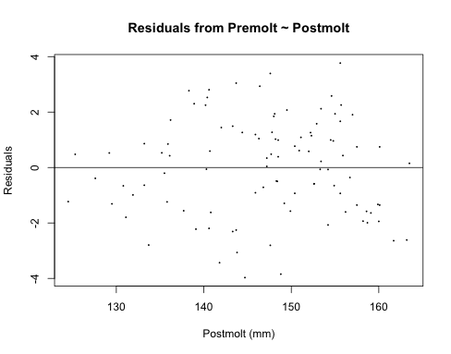
Residuals
Plot the pairs
(postmolt size, residual)

Slide 42
Variation – Explained and Unexplained

Slide 43
Total Variation. AKA Sum of Squares

Slide 44
Variation – Explained & Unexplained
Total
Variation
Unexplained
Variation
Explained
Variation

Slide 45
Regression from the Scatter Plot Perspective
a
b
Regression line
c
d
e
f

Slide 46
Regression from the Scatter Plot Perspective
Regression line

Slide 47
Regression from the Scatter Plot Perspective
Residual –
Unexplained variation
Regression line
Point of averages
Explained variation

Slide 48
Regression & Inference

Slide 49

Question: Do 720 5-kg cats produce more heat than 1 3600 kg elephant?
Or, the story of the spherical cat

Slide 50
Kleiber’s Equation
Does a horse produce more heat per day per kilogram of body mass than a rat?
This is a question studied by Kleiber (1947), Clarke (2010)
Metabolic Rate: kilocalories per day
Mass in kg
He measured 19 animals (mouse, dog, cat, goat, man, cow, elephant…)

Slide 51
Kleiber’s Data
Population – a typical ”mammal”
Sampling Frame - - an experiment is not possible here
How were the subjects obtained? From a population, a random sample, or a sample of convenience?
Sample of convenience

Slide 52
Metabolic Rate is highly skewed
Log Metabolic Rate is less skewed.

Slide 53
Mass is also highly skewed
Log Mass is less skewed.
The skew is in the other direction

Slide 54
How do these two quantities vary together?

Slide 55
Response & Explanatory Variables
Y is the response variable aka dependent variable
X is the explanatory variable aka independent variable aka feature
Which is which in our example?
Y - Metabolic Rate
X – Mass
Because Kleiber’s question is to explain metabolic rate in terms of mass

Slide 56
Examine the Joint Distribution
The histograms do not give us information about how the two variables vary together

Slide 57
Kleiber’s Data
One point makes it difficult to see the relationship between these variables

Slide 58
Deviations of the observed metabolic rate from the regression line
The error about the regression line is the root mean square error loss.
It is like an SD of the regression line.
Response
Explanatory

Slide 59
A Log-Log Relationship
Linear relationship between log(x) & log(y)
Intercept
Slope
Same b as above
We typically use “log” to represent the natural log.
The base does not impact the shape of the relationship.

Slide 60
A Log-Log Relationship - interpretation
50% increase in x
corresponds to a 1.5^b % change in y
Log-log relationships are usually expressed in terms of %change in x and y

Slide 61
Method of least squares
Minimize the average squared loss (L₂ loss) when predicting log(rate) from log(mass)
Here we minimize with respect to a and b.

Slide 62
Return to our Fitted line
Line has slope 0.75

Slide 63


Question: Do 720 cats produce more heat than 1 elephant?
5 kg
3600 kg

Slide 64
What does the slope of the line tell us?
Or
If body mass of elephant is 720 times that of a cat, then metabolic rate is 720^{0.75} = 140-fold greater than a cat’s

Slide 65
Question: Do 720 cats produce more heat than 1 elephant?
5 kg
YES!
140 cats have the same metabolic rate as 1 elephant
3600 kg

Slide 66
Question: Why not just use the values for cat and elephant, rather than fitting a line?
5 kg
If this relationship holds for mammals in general then we gain in accuracy by using a line fitted to all of the data
3600 kg

Slide 67
Question: If we feed our cat enough to gain 3595 kg, will it produce the same heat as an elephant?
5 kg
NO!
That’s silly!
This is an observational study.
We have observed a relationship between mass and metabolic rate.
It is not a causal relationship.
3600 kg

Slide 68

Question: Can we estimate the metabolic rate for a 135,00 kg blue whale using our regression line?
5 kg
Best not – It would mean extrapolating well beyond the range of the original data and we don’t know if the same linear relationship still holds.
135000 kg

Slide 69
Inference & Bootstrapping
Why is the slope ¾?

Slide 70
Why is the slope ¾?
An alternative theory is that the exponent should be 2/3 because of the relationship between mass and surface area.
The spherical cat:

Slide 71
Explain 2/3

Slide 72
Why isn’t the slope 2/3?
Statistical Models are not the same as physical models.
Statistical models can be used to infer
Statistical models can be used to predict

Slide 73
Test the hypothesis: slope = 2/3
Null Hypothesis: true slope is 2/3 AND
the observed difference between fitted coefficient and the true coefficient of 2/3 is due to chance in the sampling of the mammals
How to get a sense of this chance?

Slide 74







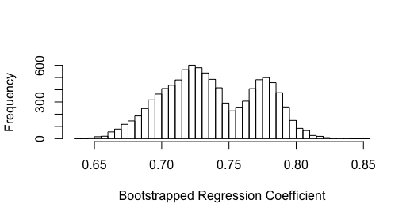
Bootstrapping
Population
My Sample
Bootstrap
Population
Bootstrap Sampling Distribution of the Coefficient
Bootstrap Coefficients
Bootstrap Samples

Slide 75
Bootstrapping - Ideas
The sample of mammals should look like the population of mammals
Imitate the data generation process by sampling from the bootstrap population; call it the bootstrap sample .
Substitute our sample for the “population”; call it the bootstrap population
Fit a linear model to the bootstrap sample.
Repeat many times and examine the variability in the bootstrapped coefficient

Slide 76
Bootstrap the coefficient
Bootstrap population: 19 (x,y) pairs of mass and metabolic rate
Bootstrap sample gives us a bootstrap statistic - the slope of the regression line
Take 10,000 bootstrap samples from the bootstrap population
Examine the distribution of bootstrapped coefficients.
If 2/3 is not within the (0.025, 0.975) percentiles of the bootstrapped distribution of the coefficient, then reject the hypothesis

Slide 77
Bootstrap Sampling Distribution
Based on these percentiles we would reject the hypothesis that the slope is 2/3. But…
Why does it look like that?
Does this mean that we shouldn’t be doing the bootstrap?
Percentiles:
0.025 percentile is 0.673
0.975 percentile is 0.799

Slide 78
Kleiber’s rule studied by Clarke (2010)
Slope remains 3/4

Slide 79
Statistical Models
To be useful must be an accurate description of data
Can assist in discovery of physical facts or social phenomena
Physical models may suggest a particular relationship, which we can fit and test.
Wish to generalize beyond the subjects studied (even when an entire population is studied)

Slide 80
Summary Points
With observational studies we cannot make causal claims such as increasing mass by 1 kg leads to a predicted increase in metabolic rate.
It’s not a good idea to extrapolate beyond the range of values observed.

Slide 81
Summary Points
Even a high correlation, need not mean the relationship is linear.
Residual plots help us determine the adequacy of the fit.
Depending on the situation, we may be satisfied with a less complex model that does not fit the data as well, if the size of the errors are tolerable.

Slide 82
Extensions to Simple Linear Regression
Multiple regression
Linear algebra
Geometric interpretation
Qualitative variables
explanatory (x)
response (y)
Prediction & Inference
Probability Model
Bias-Variance tradeoff

Slide 83
Extensions to Simple Linear Regression
Variable Selection
Feature engineering
Test-train split
Cross-validation
Regularization
Loss – L₂, L₁, and Huber
Minimization – L₂
Gradient Descent

